Slide 1
Dealing with non-CMIP ensembles Some tips and tricks resulting from ~4.5 years of struggles
Arthur Oldeman – ESM meeting 14 may 2024

Slide 2
What will be treated?
Basically my current workflow for model ensemble data management, processing and standardization (and analysis)
With some critiques, suggestions, and tips

Slide 3
Our aim…
Let’s say you want to investigate monthly variability of atmosphere and ocean interaction on basin scale in a non-CMIP ensemble of different climate models…
(based on a personal journey)
For example… El Niño and North Pacific atmosphere teleconnections, or… AMOC and the North Atlantic Oscillation, or… Southern ocean variability and surface winds, …

Slide 4
Step 0 : think about what we actually need?
I want to analyze:
100 years monthly data
SSTs (ocean) and precipitation (atm)
Of 2 different simulations
From 17 different models (PlioMIP2)

Slide 5
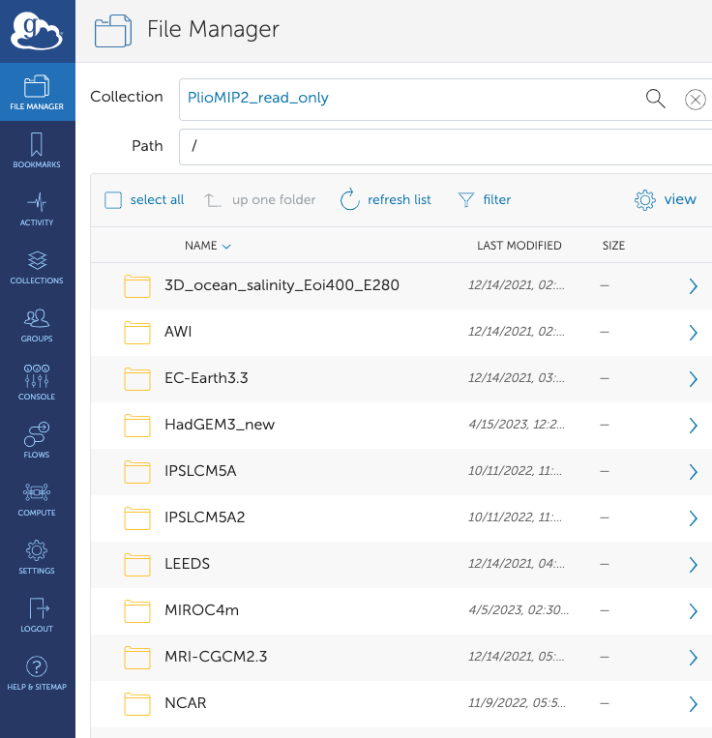
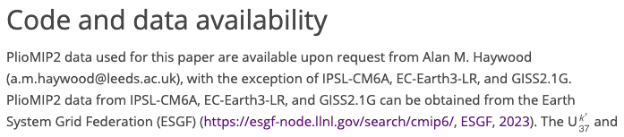
Step 1: Collecting the data
1a. Find the data
Globus server:
access by emailing someone
(stated in the “data availability” section of papers..)

Slide 6
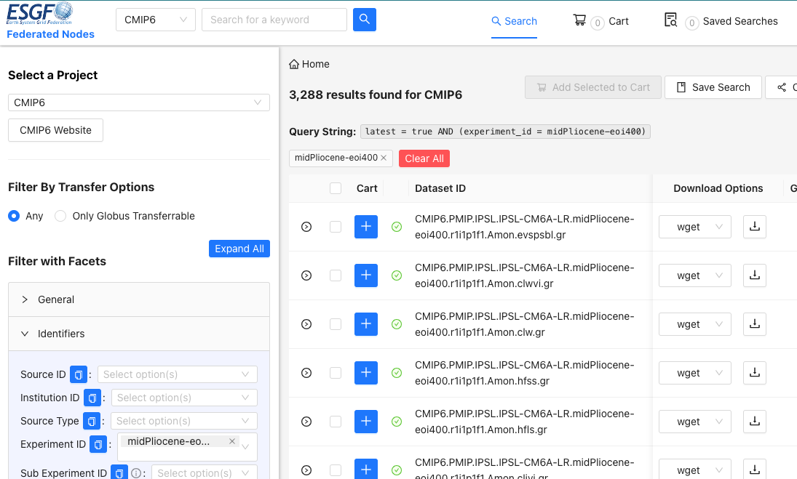
Step 1: Collecting the data
1a. Find the data
Some (CMIP6) are on the ESGF grid
(can’t find if you search for “pliomip” …)
Following FAIR principles… Not very findable and accessible. Could/should be improved!

Slide 7
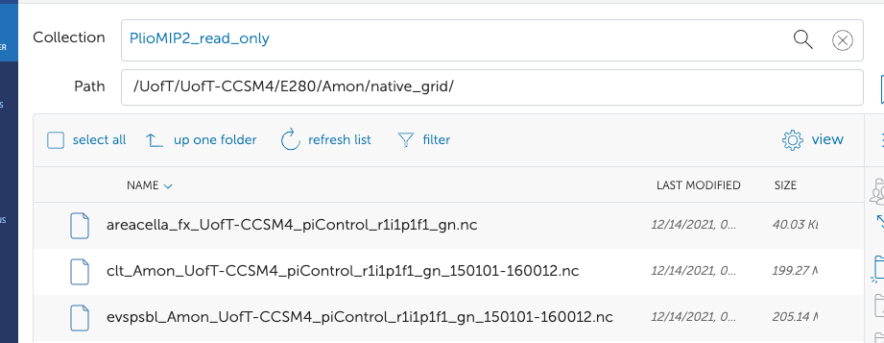

Step 1: Collecting the data
1b. Download the data
Most models: folder structure
group > model > simulation > atm/ocean > clim/monthly > 1 .nc file for 100 year monthly SSTs.
Nice!

Slide 8
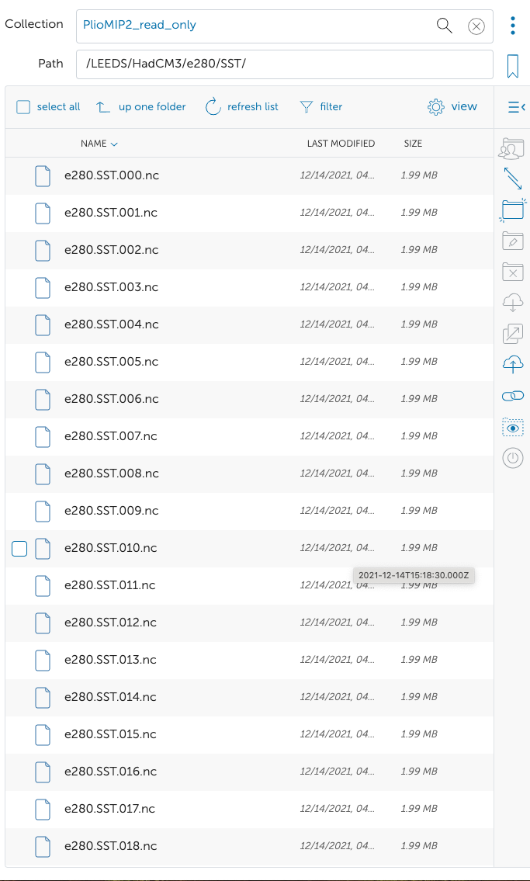
Step 1: Collecting the data
1b. Download the data
Some models… 1 file per year!
No problem if you can run a script that downloads automatically, but…
server only allows for 1 download at the same time! and opens a popup tab every time :’(

Slide 9
Ok, now we have all the data. Now we (pre)process it so it is ready for analysis

Slide 10
Step 2: (pre-)processing and standardization
Some (small / annoying) issues:
Very different file names
Same variables in different units (precipitation in mm/day or m/s or kg/m/s)
Naming conventions not the same (lat or latitude, time or month)
Time not the same (model years different + monthly mean timed in 15jan or 1feb)
Lat, lon grid not the same (might require regridding)
Concat yearly files
Total precip not always output (convective + large-scale)

Slide 11
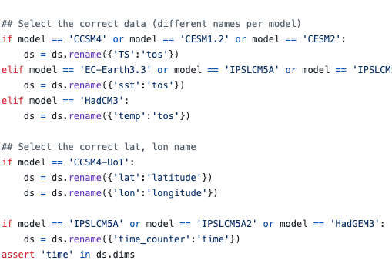
Step 2: (pre-)processing and standardization
What I used to do (Do not try this at home):
Loads of if statements
If model A: do ds.lat>xxx
Elif model B: do ds.latitude>xxx
NOT recommended!

Slide 12
Step 2: (pre-)processing and standardization
Now: standardize the data BEFORE analysis.
Including:
Renaming coordinates and variables
Normalise variable to 1 consistent unit
Give a ‘dummy’ time
Resave with same file naming convention

Slide 13
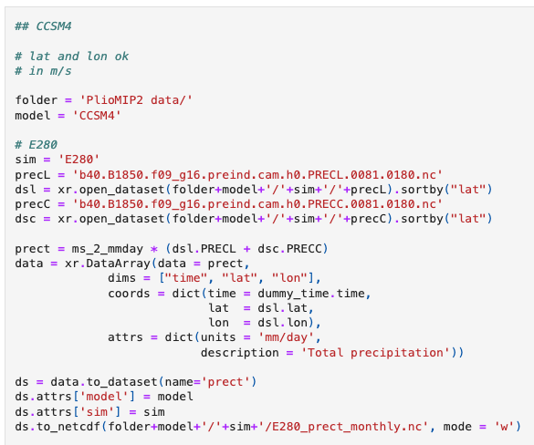
Step 2: (pre-)processing and standardization
Example:

Slide 14
Step 2: (pre-)processing and standardization
Standardization saves me time in analysis! And makes for cleaner codes.
But…
standardizing still costs me and every other researcher using the data time that could have been saved by a clearer protocol (or: groups actually following protocol) for providing/naming the data

Slide 15


NOT Step 2: regridding
What I (learnt to) not do here is: regridding
Why not?
Regridding should ideally be done at the latest stage possible, i.e. just before you want to compute an ensemble mean to plot it.
Regridding/interpolation can smooth out spatial variations and local extremes (but also suppress certain unreliable gridbox scale features)
Ultimately you change your data

Slide 16
NOT Step 2: regridding
What I (learnt to) not do here is: regridding
Why not?
Relevant since PlioMIP2 has varying ocn/atm resolution (roughly ranging from 1x1deg to 3.5x3.5deg!)
For some analyses, I need an area-averaged time series (El Nino index). Then, regridding is not necessary and can only introduce unnecessary biases.
Ok.. Must admit: OK for atm (rectangular), ocn more challenging

Slide 17
Ok, now we standardized the data. Now we can analyze it!

Slide 18
Step 3: Analyze data
Not the main focus of this talk, but will highlight two examples
Ensemble mean spatial field
Area averaged time series

Slide 19
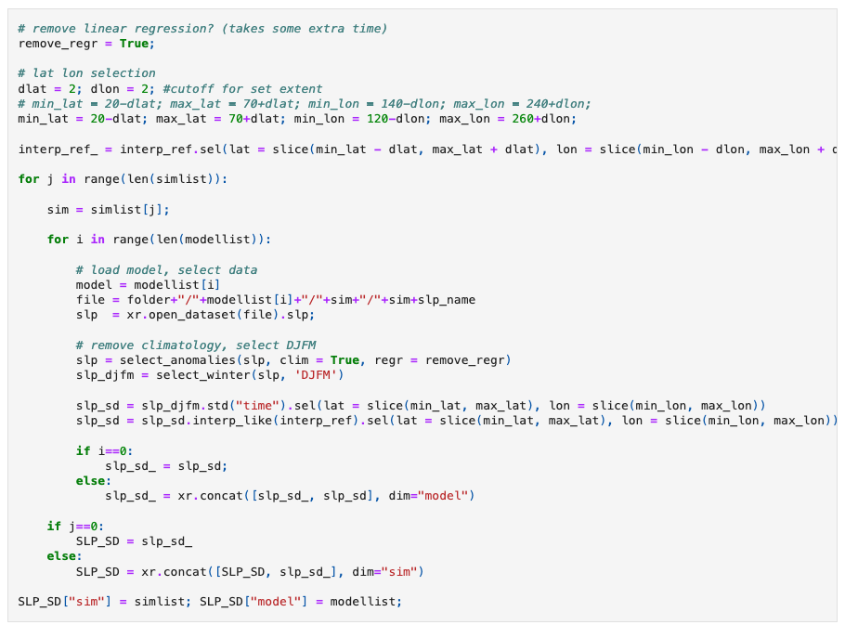
Step 3: Analyze data
Def interpolate ref
Loop over models and sims
Load data. Easy!
Remove clim, select winter
Compute and interpolate
ds.var.sel(sim = “sim 1”).mean(“model”).plot()
Combine in one ds

Slide 20
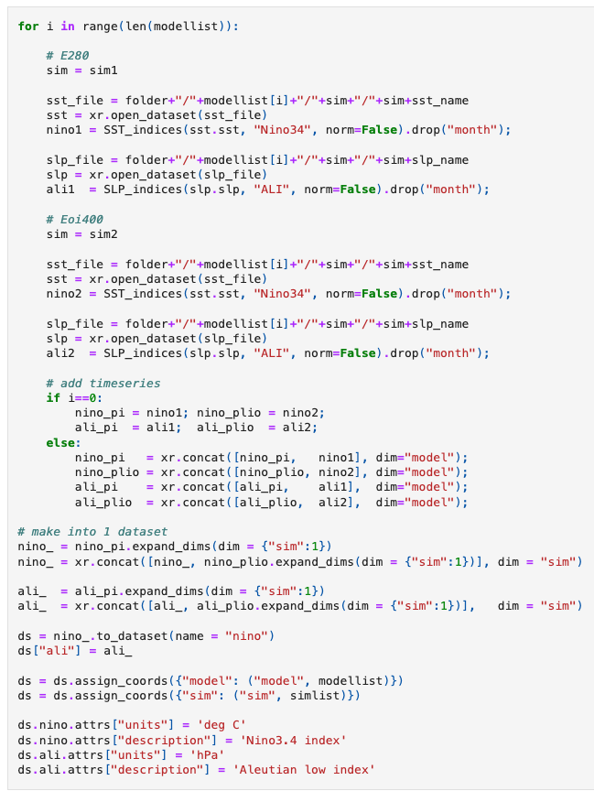
Step 3: Analyze data
Calculate El Nino indices

Slide 21
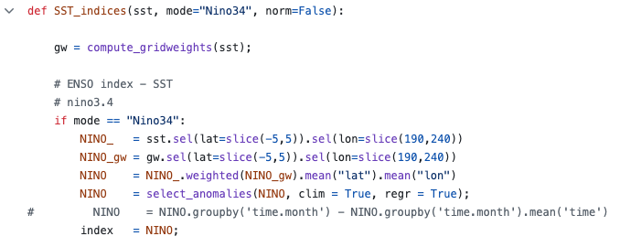
Step 3: Analyze data
Loop over models
Open data (easy) and compute index per sim
..
Compute gridweights
Select area
Compute weighted area average
Compute index

Slide 22
Step 3: Analyze data
..
Concat the data
Making 1 dataset incl. some info

Slide 23
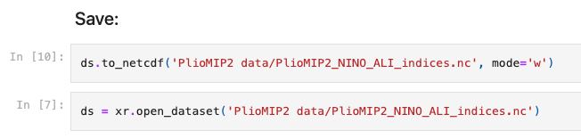
Step 3: Analyze data
Save!
& reopen later to save time
ds.nino.std(“time”).plot()

Slide 24
Take aways:
Make sure your data meets FAIR principles
Design consistent and clear MIP protocol (and try to have model groups follow the conventions!)
Pls don’t call your January monthly mean “February 01”
My tip: standardize & resave your ensemble data before analysis
Regrid at the latest moment (or: don’t)
code from:
https://github.com/arthuroldeman/PlioMIP2-ENSO-teleconnection/tree/main

